Slide 1

Lab Exercise

Slide 2

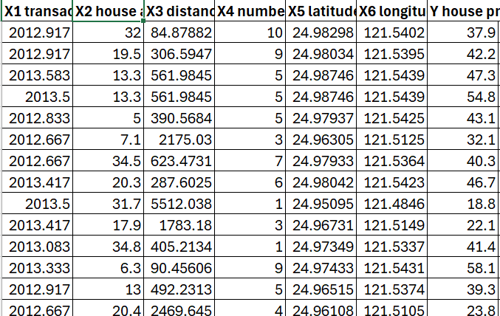
Real Estate Data

Slide 3

Tasks
1. Remove the duplicate values
2. Perform data profiling
3. Outlier detection on Y house price of unit area using the Interquartile Range (IQR) rule.

